Slide 1
Bollinger Bands & Mean Reversion Buy/Sell Signals
Ameen Zia, Hillary Bhuiyan, Jake Wicks, Yash Shah

Slide 2
Agenda
Introduction & Background
Thesis
Results
Analysis
Conclusion
Citations/Q&A

Slide 3
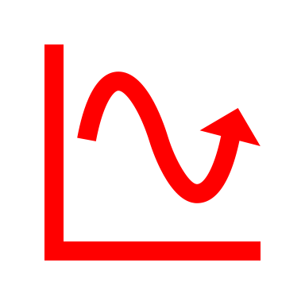

Introduction
Prices have a habit of ping-ponging between bands—especially in range-bound conditions; this makes Bollinger Bounces useful for mean reversion setups. However, these are not blind trade triggers. Not only that, but there can also be a lot of noise which can make it hard to reach conclusions.
Moving Average
Kalman Filter
Confirm With:
Thesis: This presentation demonstrates a robust quantitative trading strategy that leverages Kalman filters to dynamically estimate the hedge ratio between XLE (Energy Sector ETF) and AMD (Advanced Micro Devices), constructing a mean-reverting spread whose signals are refined using Zero-Lag Moving Averages (ZLMA) and confirmed with MACD crossovers; by integrating statistical filtering and momentum confirmation, the strategy targets optimal entry/exit points to maximize cumulative returns and achieve a Sharpe ratio exceeding 1.0 in volatile market conditions.
Implementation: We can avoid trading bands during strong trends—waiting for consolidation or pullbacks to improve odds of returns

Slide 4
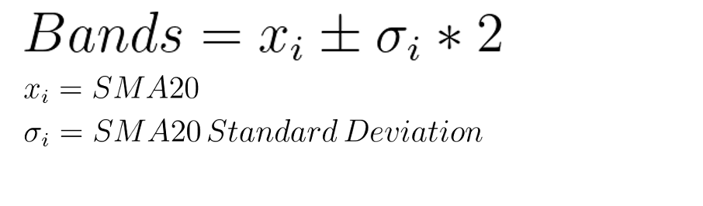
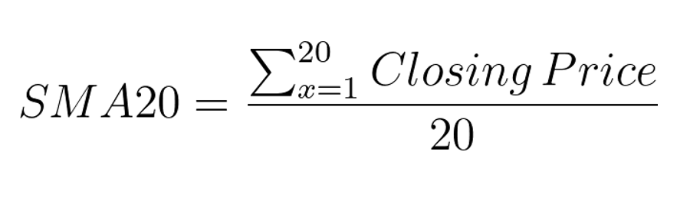
Bollinger Bands and Mean Reversion
WHAT ARE THEY?
Bollinger Bands
Mean Reversion
Definition: Momentum lines (bands) plotted x standard deviations (positive and negative) away from the SMA line
Definition: Theory that asset prices tend to revert to their average over time
Purpose: Indicate price volatility and help identify potential overbought or oversold conditions
Purpose: Capitalize on temporary price extremes, with the assumption prices will revert to their means
Equation
Equation
Key Point: When the upper and lower bands are further apart from each other this indicates high volatility and vice versa!

Slide 5
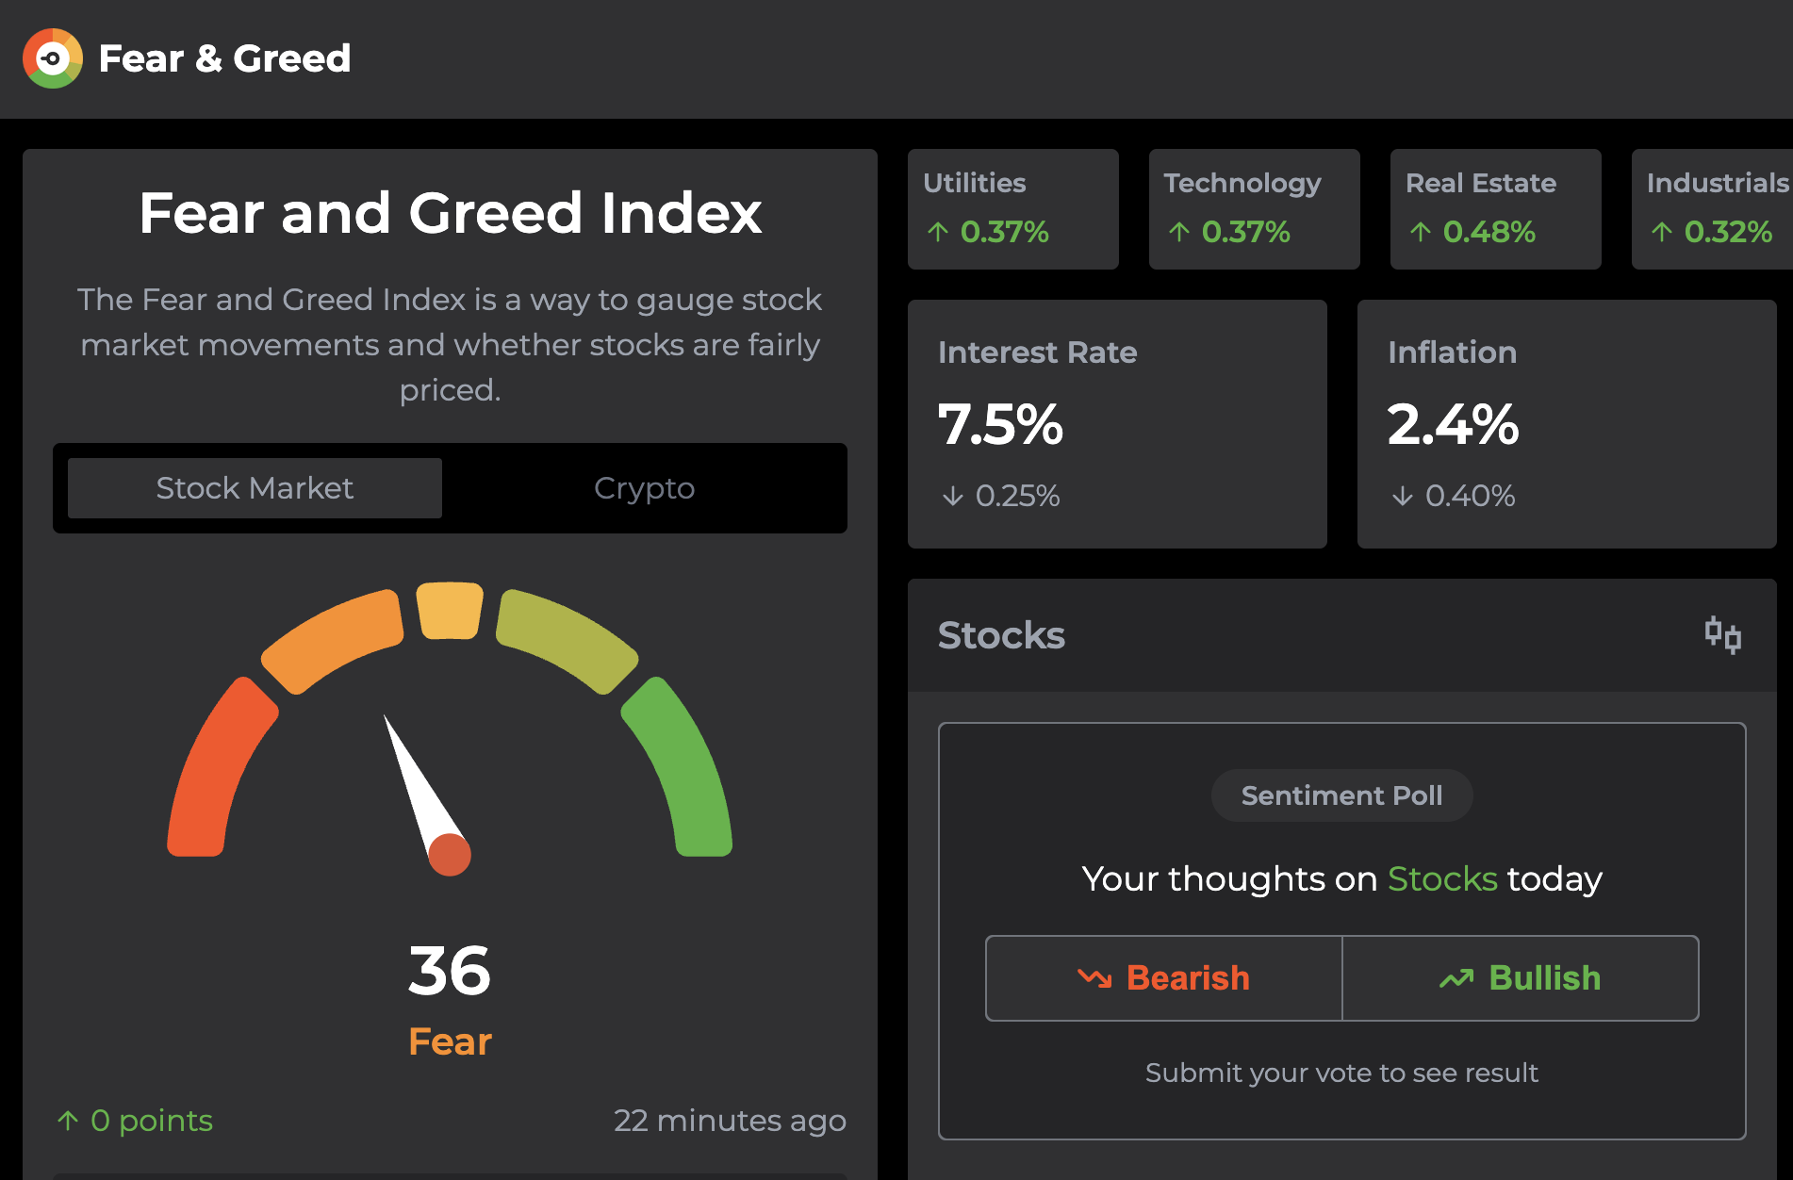
Key Tools
Market Sentiment: The overall mood of investors towards the market (bullish/bearish). This is useful for our strategy to time the entry and exit points.
Price changes in relation to the Moving Average, thus sensing greed/fear will help identify buying points.
Top Band = Overbought | Lower Band = Oversold
Volume: How much the equity is being traded in a specific period.
If share prices are rising but there’s less volume, this indicates a weak feeling towards the security
If share prices are falling with high volume, this indicates a strong feeling towards the security
Fear & Greed Index

Slide 6
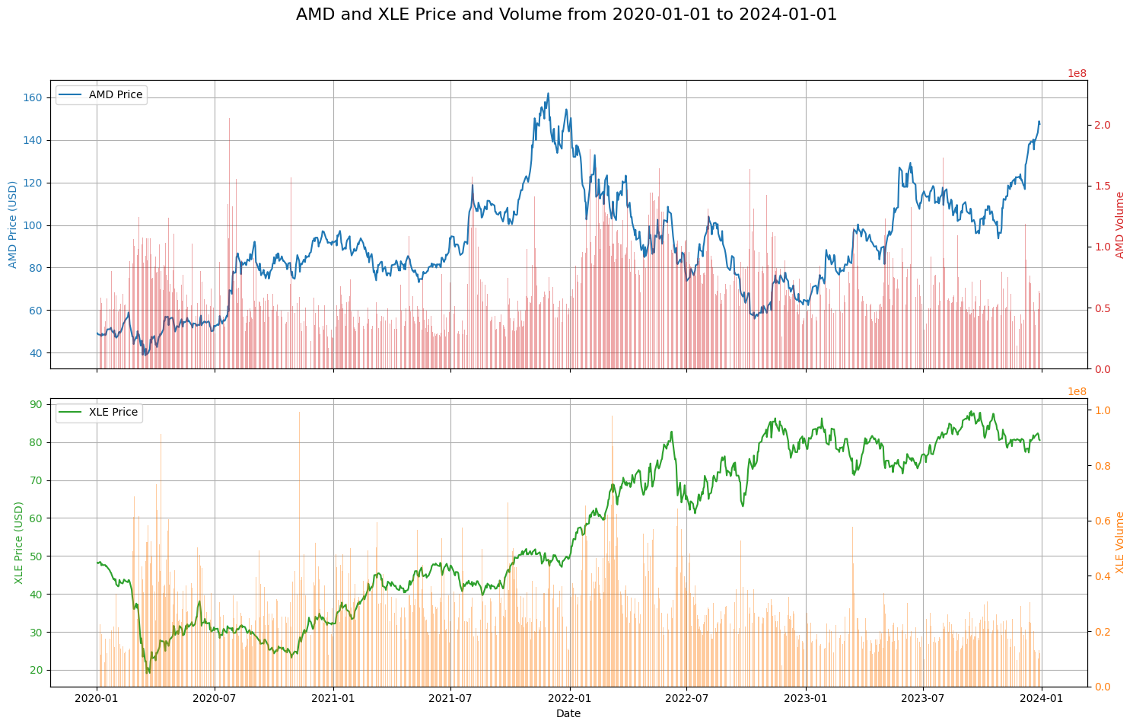
Data
Historical Data Needed:
We will be using a 5-year time frame from January 2020 to January 2024 to model our data
Open
High
Low
Close
Volume
Iteration: The data will loop through the historical data, starting from the period required for the Bollinger Band calculation.

Slide 7
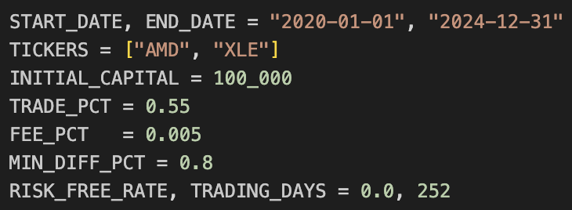
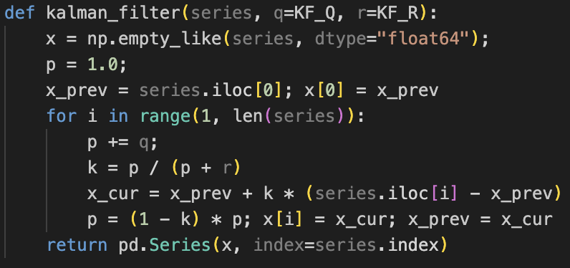
Strategy
Starting Capital: $100,000
Position Size: 55%
Buy Signal: Checks if both AMD and XLE prices cross above their lower Bollinger Bands. If met, Buy Signal Generated
Sell Signal: Checks if either AMD price or XLE price crosses below the upper Bollinger Band. If met, Sell Signal Generated
Interpretation: By identifying potential oversold/overbought conditions in these assets, we aim to generate buy and sell signals. Historical data will be used to back test entry and exit rules and assess the strategy's potential for outperformance.

Slide 8
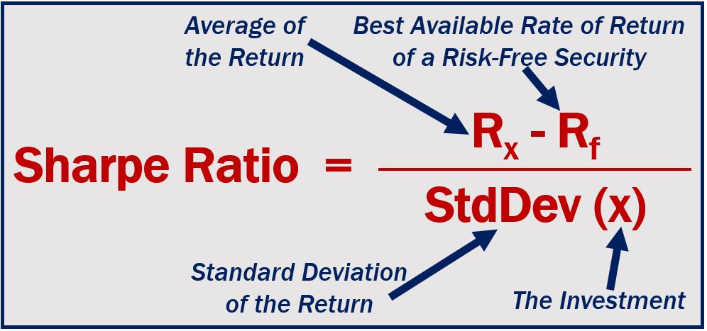
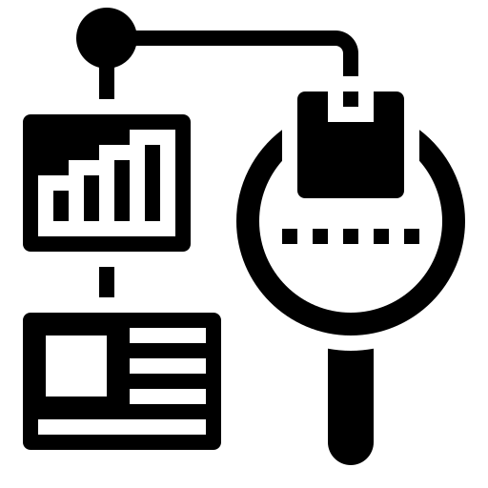
Back Testing Analysis
Sharpe Ratio:
Interpretation Table:
Definition: The Sharpe Ratio is a measure of risk-adjusted return. It allows investors to compare the performance of different investments by considering both the returns and the risks involved. The higher the Sharpe Ratio, the better the investment’s risk-adjusted performance.
Ratio #
Inference
<1
Bad
1-1.99
Adequate/Good
Strategy Sharpe Ratio: 1.13
2-2.99
Very Good
>3
Excellent
Back testing done by looking at key performance metrics such as:
Sharpe Ratio
Final Cumulative Return
Final Value of Strategy

Slide 9
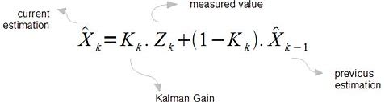
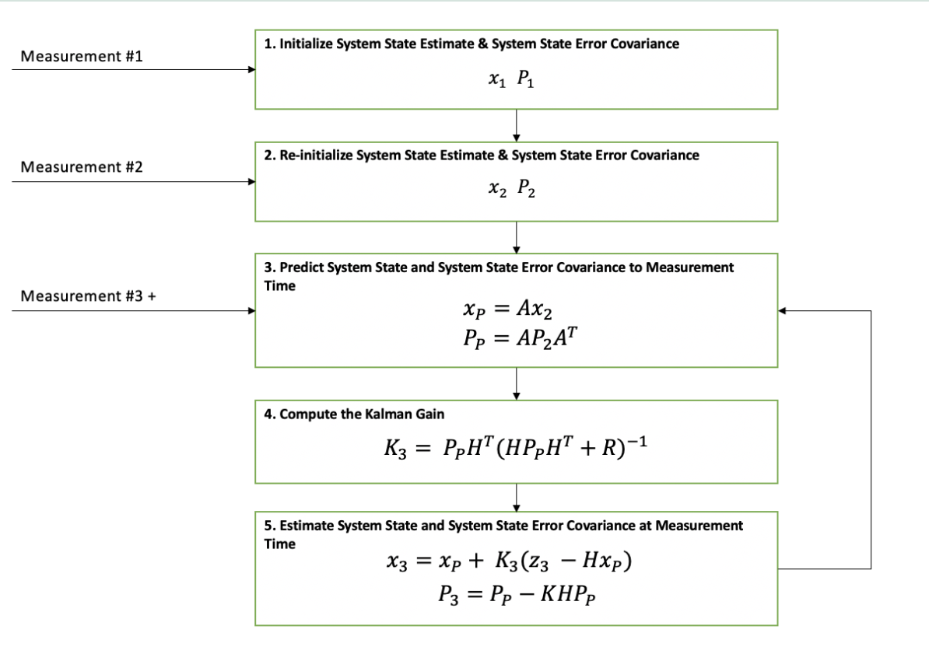
Mean Reversion Algorithm
Kalman Filter:
Definition: Kalman filters were developed by Rudolf Kalman in the early 1960s to solve the problem of managing uncertainty and noise in data. Nowadays, they are great for extracting meaningful information from noisy data. Mathematically, Kalman Filters are called linear quadratic estimators. This is because, in the process of estimating the future based on current and past data, Kalman filters use MR and ZLMA.
Mean Reversion in Finance
Mean reversion is the tendency of a price or spread to return to a long-term average over time. Strategies like pairs trading and statistical arbitrage often rely on this concept.
Kalman Filters
Kalman filters are recursive algorithms used to estimate the hidden state of a system over time. In finance, they are often used to dynamically estimate parameters of time-varying models. Basically, a really fancy "MACD" (momentum indicator in technical analysis of securities prices).
Zero-Lag Moving Average (ZLMA)
ZLMA is a type of smoothed moving average designed to reduce lag compared to traditional moving averages like the simple or exponential moving average. It aims to track price (or another time series) more responsively, making it useful in real-time trading systems — including those using Kalman filters.

Slide 10
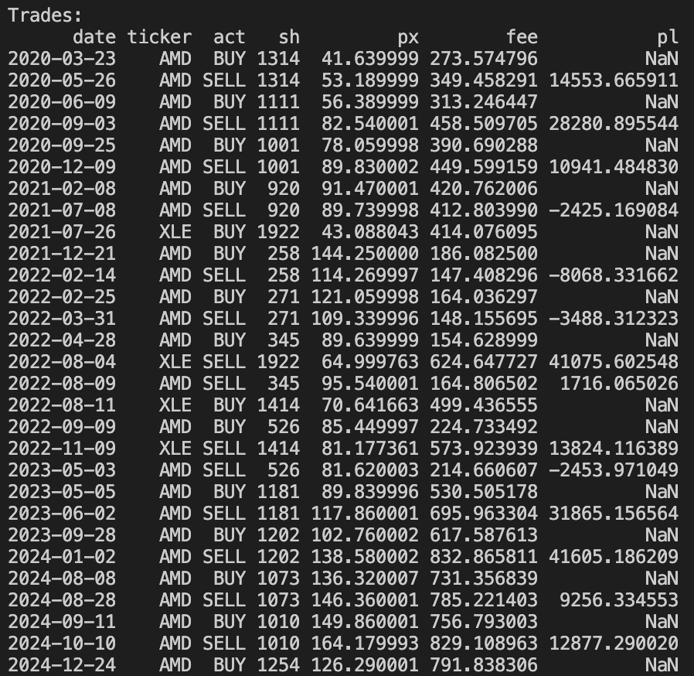
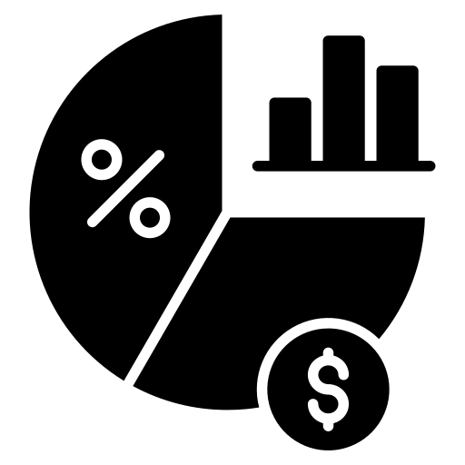
Results
Number of Trades: 29
Ending Capital: $283,940.28
Return: 183.94%
Sharpe Ratio: 1.129

Slide 11
Citations
Kearns, M. (n.d.). Filtering in finance. University of Pennsylvania. Retrieved from https://www.cis.upenn.edu/~mkearns/finread/filtering_in_finance.pdf
İlarslan, S. (2020, February 17). Implementing a Kalman Filter based trading strategy. Medium. Retrieved from https://medium.com/@serdarilarslan/implementing-a-kalman-filter-based-trading-strategy-8dec764d738e
The Kalman Filter. (n.d.). Kalman filter explained simply. Retrieved from https://thekalmanfilter.com/kalman-filter-explained-simply/
Wikipedia contributors. (2023, December 19). Zero lag exponential moving average. Wikipedia. Retrieved from https://en.wikipedia.org/wiki/Zero_lag_exponential_moving_average
Fidelity Investments. (n.d.). Bollinger Bands. Retrieved from https://www.fidelity.com/learning-center/trading-investing/technical-analysis/technical-indicator-guide/bollinger-bands
Wikipedia contributors. (2023, November 3). Mean reversion (finance). Wikipedia. Retrieved from https://en.wikipedia.org/wiki/Mean_reversion_(finance)

Slide 12
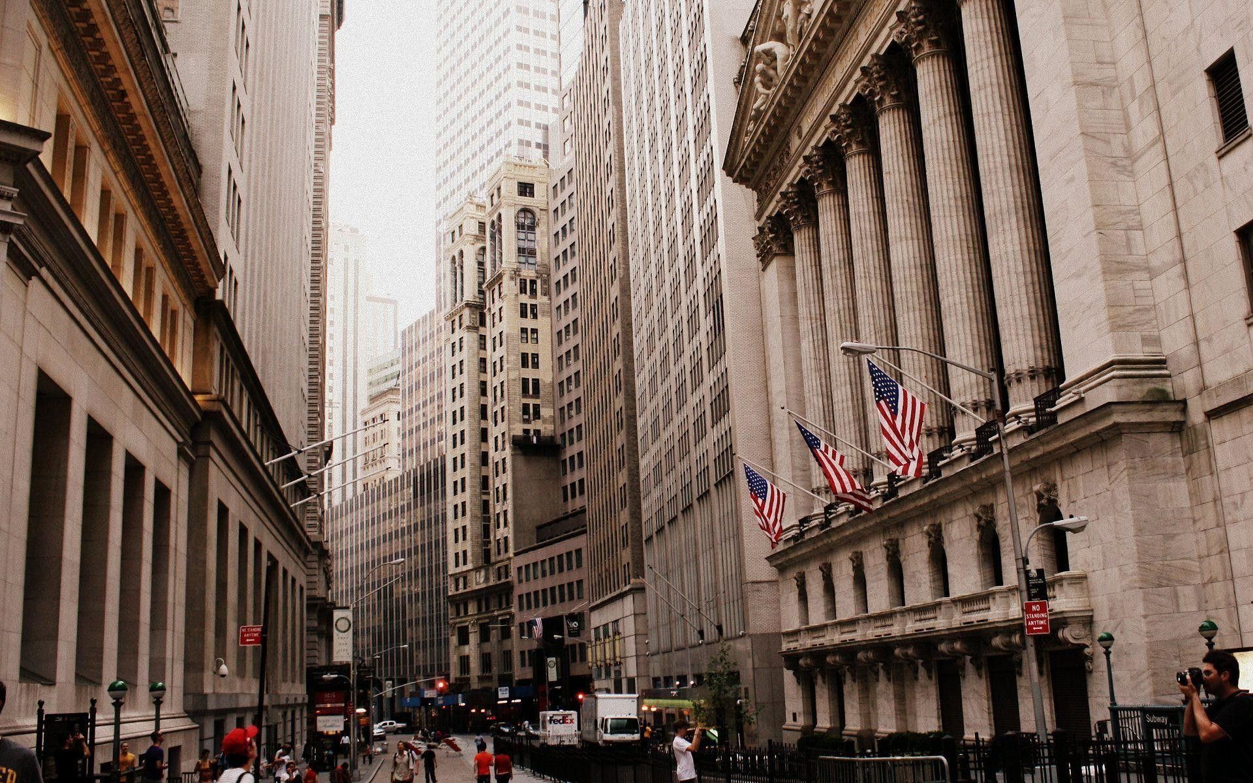
Q&A

